Slide 1
Long Duration Aeroacoustic Simulation
AMSC/CMSC-663 – Project Proposal
Dilhara Jayasundara
Advisor: Dr. James Baeder

Slide 2
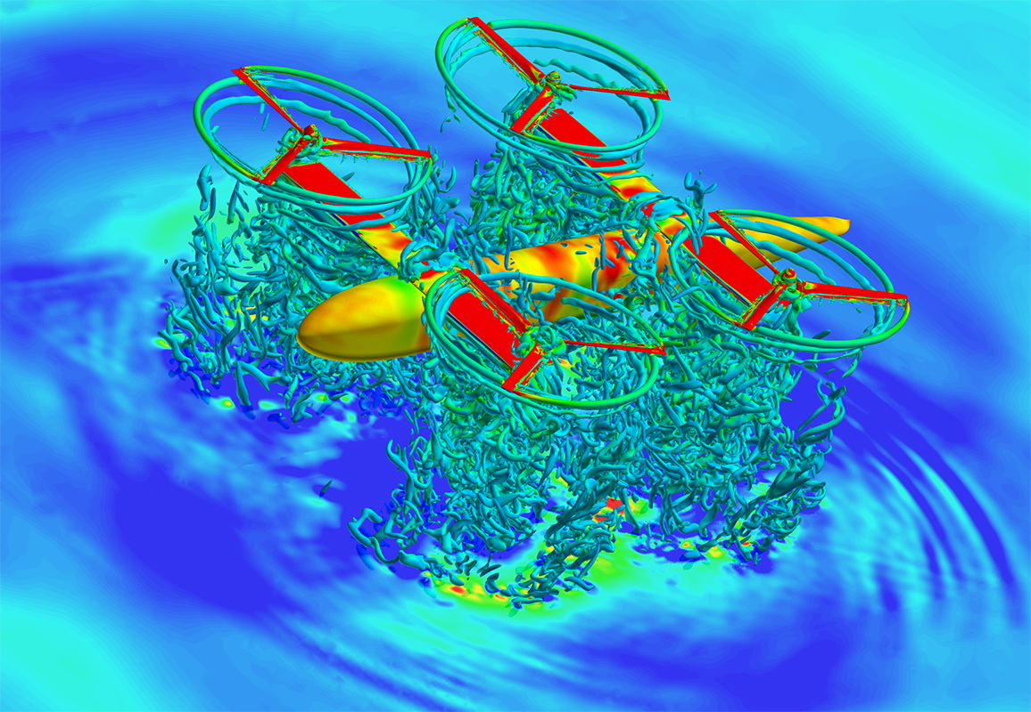
Outline
Introduction
Binning Approach
Project Goals
Computational Approach
Algorithm
Validation
Deliverables/Timeline

Slide 3
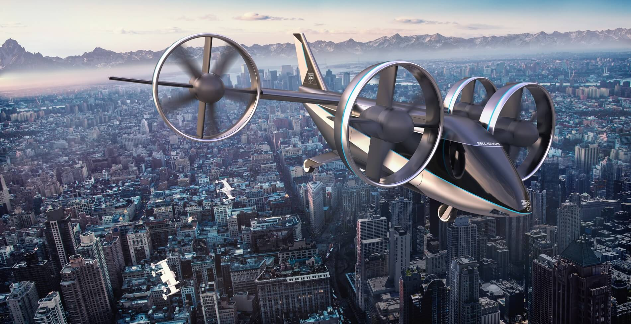
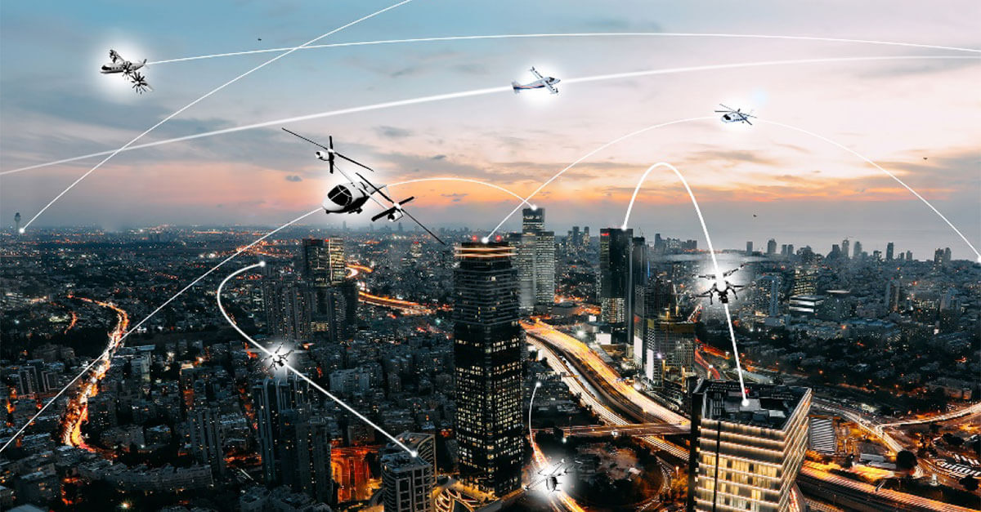
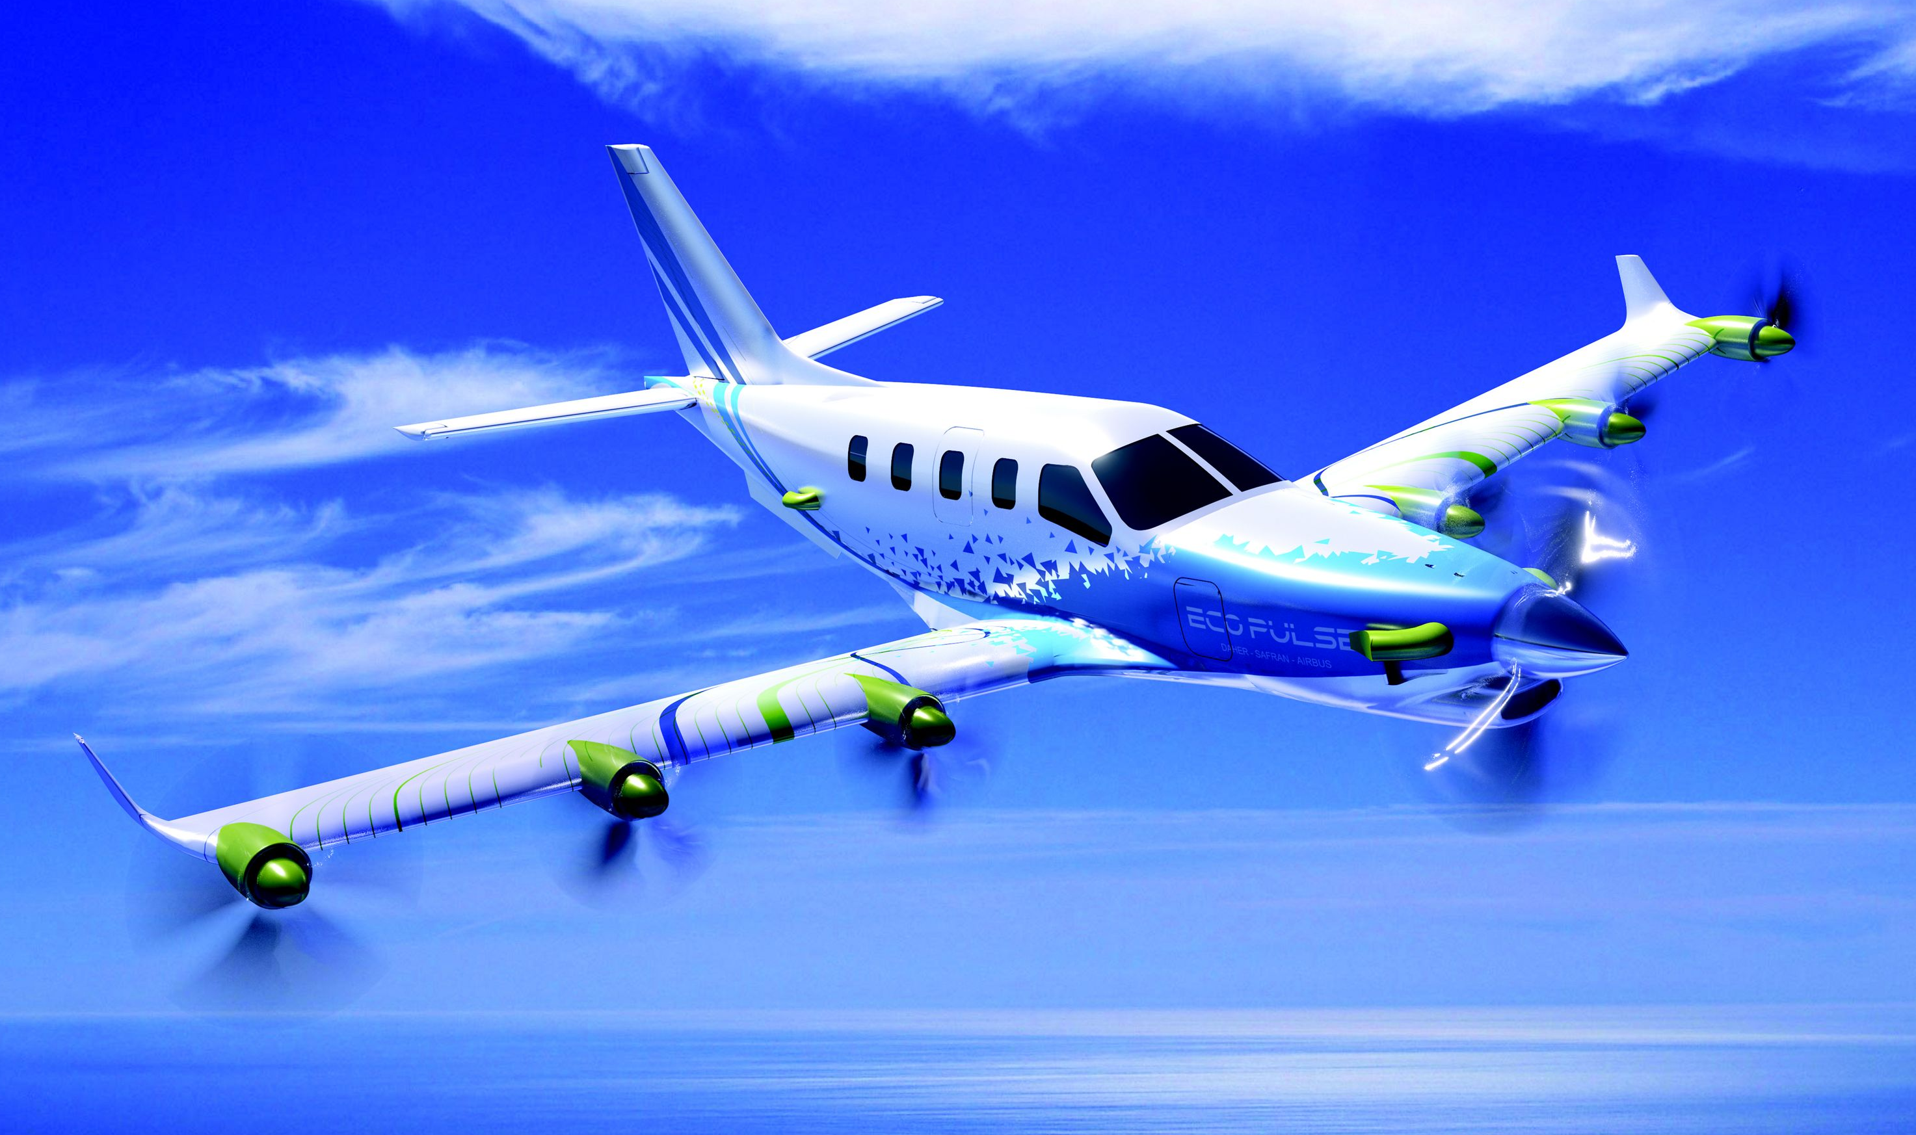
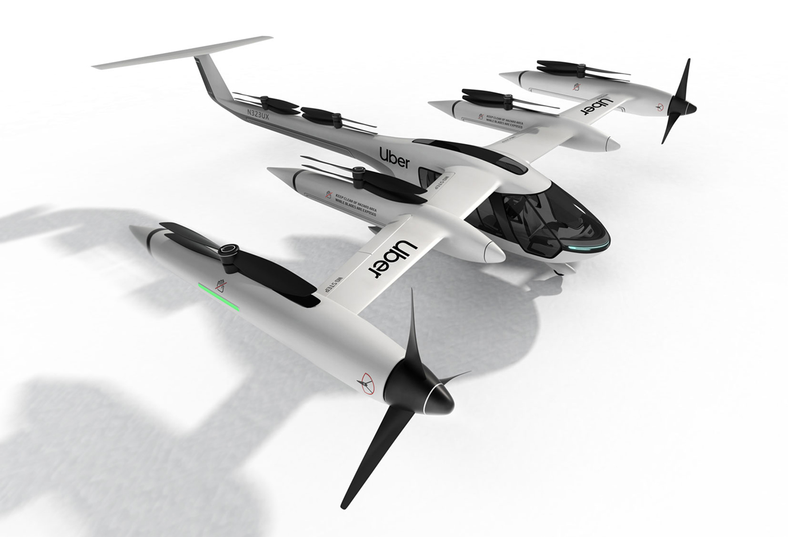
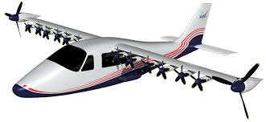
Introduction
Aeroacoustics
Why important?
Emergence of Urban Air Mobility – eVTOLs
Main source of thrust is propellers - - > Propellers are noisy..!
More air vehicles in urban environments - - > More noise..!
Passenger and pedestrian discomfort - - > Critical challenge to the industry
Hybrid-Electric propulsion
Lower emissions
Lower fuel usage
Lower noise..!
To reduce noise - - > Understand the physics..!
Flight tests
Wind tunnel tests
Computational tools – computational aeroacoustics
Bell Nexus³
Uber Elevate²
NASA X-57 All-electric aircraft⁵
EcoPulse – Hybrid propulsion aircraft⁴
NASA’s vision on UAM¹
Notes:
Uber – begin commercial operations in 2023 in LA, Texas and Melbourne

Slide 4
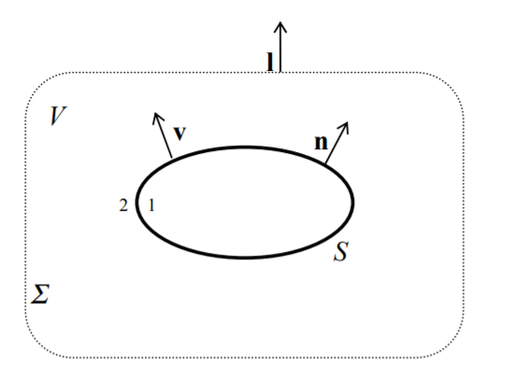
Ffowcs Williams – Hawkings Equation
Rate of change of mass within V,
By divergence theorem,
If f = 0 defines surface S, such that f < 0 in region 1 and f > 0 in region 2,
u – fluid velocity
$$\int_{V}{\left(\frac{∂\overline{ρ}}{∂t}+\frac{∂}{∂x_{i}}\left(\overline{ρ}{\overline{u}}_{i}\right)\right)dV}=\int_{V}{\left({\left[ρ\left(u_{i}−v_{i}\right)\right]}_{2}−{\left[ρ\left(u_{i}−v_{i}\right)\right]}_{1}\right)δ\left(f\right)\frac{∂f}{∂x_{i}}dV}$$

Slide 5
Ffowcs Williams – Hawkings Equation
Generalized mass conservation,
Similarly the generalized momentum conservation,
$p_{ij}$ - compressive stress tensor
In region 1,
Fluid is at rest, $u_{i}=0$
Density, $ρ$ = $ρ_{0}$
Pressure $P=P_{0}$
In region 2,
$u_{n}=v_{n}$ (Impermeability condition)
$\frac{∂\overline{ρ}}{∂t}+\frac{∂}{∂x_{i}}\left(\overline{ρ}{\overline{u}}_{i}\right)=$ $\left({\left[ρ\left(u_{i}−v_{i}\right)\right]}_{(1)}^{\left(2\right)}\right)δ\left(f\right)\frac{∂f}{∂x_{i}}$
$\frac{∂}{∂t}\left(\overline{ρ}{\overline{u}}_{i}\right)+\frac{∂}{∂x_{j}}\left(\overline{ρ}{\overline{u}}_{i}{\overline{u}}_{j}+{\overline{p}}_{ij}\right)=$ $\left({\left[p_{ij}+ρu_{i}\left(u_{i}−v_{i}\right)\right]}_{(1)}^{\left(2\right)}\right)δ\left(f\right)\frac{∂f}{∂x_{i}}$
$$c= \sqrt{\frac{p}{ρ}}$$
$$\frac{∂}{∂t}(\text{mass} \text{conservation}\text{)} \text{−} \frac{∂}{∂x_{i}}(\text{momentum} \text{conservation}\text{)}$$
gives…..

Slide 6
Ffowcs Williams – Hawkings Equation
$$\left(\frac{∂^{2}}{∂t^{2}}−c^{2}\frac{∂^{2}}{∂x_{i}^{2}}\right)\overline{ρ′}=\frac{∂}{∂t}\left(ρ_{0}v_{i}δ\left(f\right)\frac{∂f}{∂x_{i}}\right)−\frac{∂}{∂x_{i}}\left(p_{ij}δ\left(f\right)\frac{∂f}{∂x_{i}}\right)+\frac{∂\overline{T_{ij}}}{∂x_{i}∂x_{j}}$$
Wave equation
Thickness source
(monopole)
Loading source
(dipole)
Quadrupole
source
Lighthil’s stress tensor, $T_{ij}=ρu_{i}u_{j}+p_{ij}−c^{2}\left(ρ−ρ_{0}\right)δ_{ij}$
Contribution of Lighthill’s stress tensor can be neglected for subsonic flows
Thickness source – due to displacement of volume by surface
Loading source – due to acceleration of loading

Slide 7
Solution to FW-H Equation
Using free-space Green’s function of the wave equation,
$\left(x,t\right)−observer space,time$
$\left(y,τ\right)−source space,time$
g$=τ−t+r/c$
Solving
Gives,
Pressure Wave
Source
Observer
– wave operator

Slide 8
Solution to FW-H Equation
Transform from fixed coordinates y to moving coordinates $η$
Transform from $τ$ to g
This gives,
$$4πp^{′}\left(x,t\right)=\int_{−∞}^{t}{\int_{R^{3}}{\tilde{Q}\left(η,τ\right)δ(\tilde{f})\frac{δ(\text{g})}{r}dηdτ}}$$
Doppler Factor
Notes:
1-Mr is Doppler factor

Slide 9
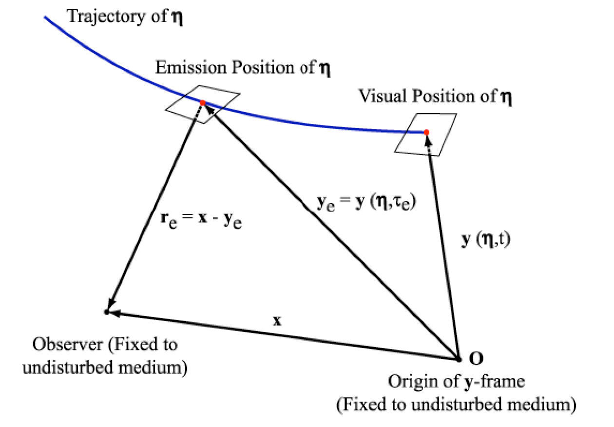
Solution to FW-H Equation
Thickness acoustic pressure,

Slide 10
Farassat’s Formulation 1
Loading acoustic pressure,
Using (proven by differentiating both sides)

Slide 11
Farassat’s Formulation 1
As with thickness acoustic pressure we can convert this to retarded time,
n
$$θ$$
r
$θ −$ local angle between surface normal and radiation direction $\hat{r}$ at emission time $τ_{e}$
Combining formulae for thickness and loading acoustic pressure,
Farassat’s formulation 1
The observer time derivative needs to be taken numerically
Increases the execution time on computer
Reduces accuracy

Slide 12
Farassat’s Formulation 1A
Taking partial derivative with respect to t,
Therefore the total acoustic pressure can be written as,

Slide 13
Farassat’s Formulation 1A
After source time differentiation,
Thickness acoustic pressure
$$4π{p′}_{T}\left(\vec{x},t\right)=\int_{f=0}{{\left[\frac{ρ_{0}({\dot{v}}_{n}+v_{\dot{n}})}{r{(1−M_{r})}^{2}}\right]}_{ret}dS}+\int_{f=0}{{\left[\frac{ρ_{0}v_{n}(r{\dot{M}}_{r}+c(M_{r}−M^{2}))}{r^{2}{(1−M_{r})}^{3}}\right]}_{ret}dS}$$
Loading acoustic pressure
$$4π{p′}_{L}\left(\vec{x},t\right)=\frac{1}{c}\int_{f=0}{{\left[\frac{{\dot{l}}_{r}}{r{(1−M_{r})}^{2}}\right]}_{ret}dS}+\int_{f=0}{{\left[\frac{l_{r}−l_{M}}{r^{2}{(1−M_{r})}^{2}}\right]}_{ret}dS+\int_{f=0}{{\left[\frac{l_{r}(r{\dot{M}}_{r}+c\left(M_{r}−M^{2})\right)}{r^{2}{(1−M_{r})}^{3}}\right]}_{ret}dS}}$$
$\vec{M}$- Mach number of the source $f=0$
$\vec{r}$ - Difference between observer ($\vec{x}$) and source ($\vec{y}$)
$\vec{l}$ - Local force acting on the fluid
$ρ_{0}$ - Freestream density
$\vec{v}$ - Surface velocity relative to the observer
$\hat{n}$ - Outward unit normal vector of the surface element $dS$
$c$ - Speed of sound

Slide 14
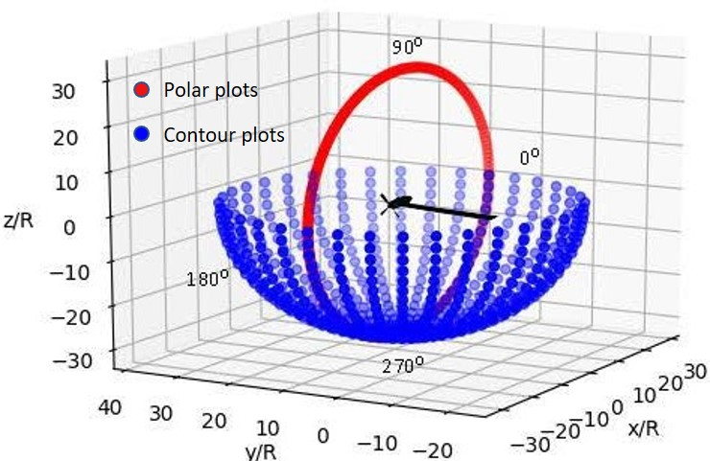
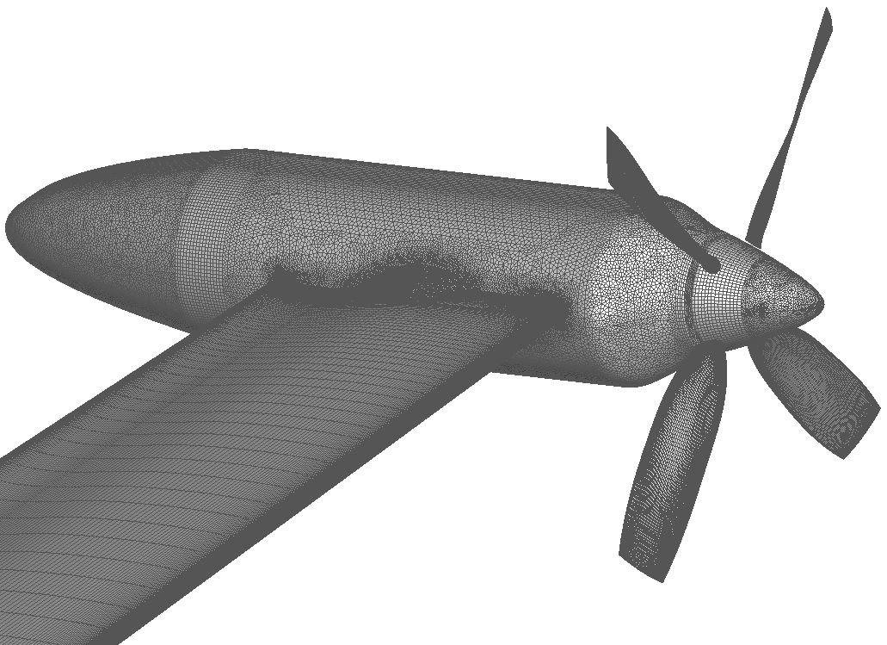
Computational Aeroacoustics
Input data
Geometric data of source surfaces
Load distribution as surface pressure
Flow conditions
Freestream velocity
Freestream density & pressure
Observer locations
Output data
Acoustic pressure at observer locations as a function of time
Thickness, ${p′}_{T}$
Loading, ${p′}_{L}$
Post processing
Overall Sound Pressure Level (OASPL) in dB
Sample Source Geometry
Observer locations
$$OASPL={20 log}_{10}\left[\frac{P−P_{mean}}{P_{ref}}\right]$$

Slide 15
ACUM⁸
Aeroacoustic Code of the University of Maryland
Two versions available
Forward in time approach and double time loop for retarded time calculation
Both rely on periodicity of input and output
Can compute acoustic pressure time history for 1 rotor/propeller revolution
ACUM-1
Restricted to blade geometries
Uses Blade Element Momentum Theory for blade load calculations
Compact chord approximation – spanwise change in loading
ACUM-2
No restrictions on geometry
Uses CFD for load calculations
Enables use of GPUs for observer and element parallelization
Time-step parallelization not possible due to double time loop
Memory limitations

Slide 16
Forward in Time Approach
for element = 1:N_{e}
for source time step = 1:N_{t}
compute acoustic pressure, p
compute observer time, t
end
for observer time step = 1:N_{t}
map to source time, $τ$
compute acoustic pressure, p by interpolation
end
end
Usually, N_{t} = 360
Serial
Cannot be parallelized..!

Slide 17
Observer-Source Time Mapping – Double Loop
Source Time Loop
T
$$t=τ+\frac{r}{c}ω$$
$$τ_{1}$$
$$τ_{2}$$
$$τ_{3}$$
$$τ_{360}$$
$$t_{1}$$
$$t_{2}$$
$$t_{3}$$
$$t_{4}$$
$$t_{360}$$
$$dt$$
$$dt$$
Interpolation
$$t_{1}$$
$$dt$$
$$t_{2}$$
$$dt$$
$$t_{3}$$
$$t_{360}$$
$$t_{50}$$
$$dt$$
$$t_{51}$$
$$dt$$
$$t_{52}$$
$$t_{360}$$
$$dt$$
$$t_{1}$$
$$t_{49}$$
Observer Time Loop
T
T
$$t=t+2πn$$

Slide 18
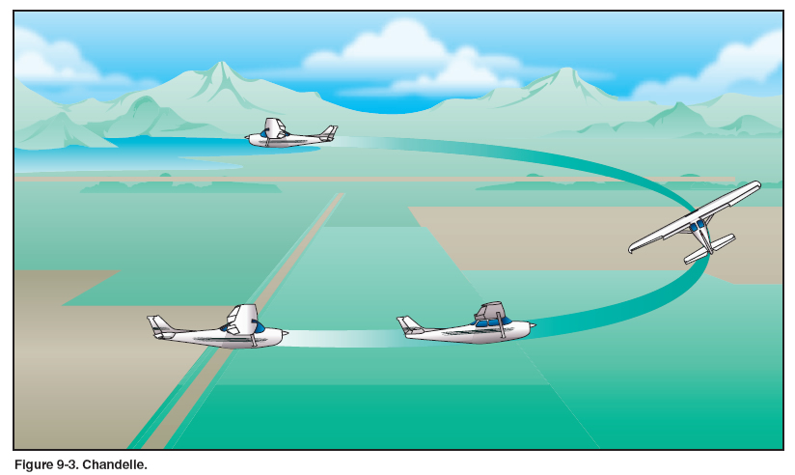
Long Duration Computations
ACUM uses input data for one propeller revolution
Makes use of periodicity for
Derivative computation
Observer-source time conversion
Cannot simulate non-periodic events
Propeller RPM change
Aircraft maneuvers
Propellers with different RPM
Flyovers
Propeller blade/propeller shaft angle of attack change
Inclusion of urban environment, e.g. Tall buildings
These require computations for at least more than 100 revolutions
Need time step parallelization

Slide 19
Binning Approach for Time Mapping
Source Time Loop
T
$$t=τ+\frac{r}{c}ω$$
$$τ_{2}$$
$$τ_{3}$$
$$τ_{360}$$
$$t_{2}$$
$$t_{3}$$
$$t_{4}$$
$$t_{360}$$
$$τ_{1}$$
$$t_{1}$$
$$t_{2}$$
$$dt$$
$$dt$$
Binning
Interpolation
$$t_{1}$$
$$dt$$
$$t_{2}$$
$$dt$$
$$t_{3}$$
$$t_{360}$$
$$t_{50}$$
$$dt$$
$$t_{51}$$
$$dt$$
$$t_{52}$$
$$t_{360}$$
$$dt$$
$$t_{1}$$
$$t_{49}$$
Observer Time Loop
T
T
$$t=t+2πn$$
Observer time loop is not required

Slide 20
Binning Approach – Problem
t₁
t₂
t₃
t₄
70%
30%
60%
40%
70%
30%
t₅₀
35%
65%
t₅₂
t₅₃
t₅₁
dt
dt
dt
Double loop approach
t₅₁ takes 65% from t₂ and 35% from t₃ = 100% of the solution
Binning approach (single loop)
t₂ provides 70% to t₅₁ and t₃ provides 40% to t₅₁
So altogether, t₅₁ gets 110% of the solution
t₃ provides 60% to t₅₂ and t₄ provides 30% to t₅₂
So altogether, t₅₂ gets 90% of the solution
This causes an error in the final solution at most time steps

Slide 21
Modified Binning Approach
t₁
t₂
t₃
t₄
t₅₀
35%
65%
t₅₂
t₅₃
t₅₁
dt
dt
dt
t_{i} calculates t_{i-1} and t_{i+1} using $t=τ+r/c$
t₂ knows t₃ – can throw 65% of its pressure into t₅₁
t₃ knows t₂ – can throw 35% its pressure into t₅₁
t₅₁ gets exactly 100% all the time
This makes the time dimension parallelizable

Slide 22
Project Goals
Develop a new version of ACUM that can process
Large amounts of timesteps
Non-periodic data
Modify CFD solver
Efficient processing of data needed for ACUM
Simulate non-periodic events
Validation
Run non-periodic cases

Slide 23
ACUM-3
Runs on GPUs
Using CUDA or OpenACC
3-D parallelization
Observers
Elements
Timesteps
Using binning approach
Operatable on HPC clusters using MPI
To avoid memory limitations
Ability to process large amounts of non-periodic data

Slide 24
Algorithm
Read inputs
Geometric data
Surface pressure
Observer locations
Preprocess inputs
Acoustic pressure computation (parallelized)
Binning approach
Write output to files
Post process to calculate OASPL at each observer
$$OASPL={20 log}_{10}\left[\frac{P−P_{mean}}{P_{ref}}\right]$$

Slide 25
Modifications to CFD
The in-house CFD solver requires capability of
RPM change
Non-linear geometric movements
Angle of attack changes
Dual mesh arrangement
CFD needs a finer mesh to prevent numerical diffusion and capture small scale turbulent structures
Acoustic computation can be done on a much coarser mesh
CFD solver should compute surface pressure on the finer mesh and store on a coarser mesh, which can be accessed by ACUM

Slide 26
Mesh Generation
The blade surface mesh is generated using Pointwise
Triangular (unstructured) and quadrilateral (structured) elements – coarser mesh
In-house mesh generation tool is used to generate the volume meshes
Surface mesh elements are subdivided into pure-quadrilaterals (unstructured) – finer mesh
Hexahedron volume meshes
Coarser mesh can be used to write pressure and geometric data for acoustic computation

Slide 27
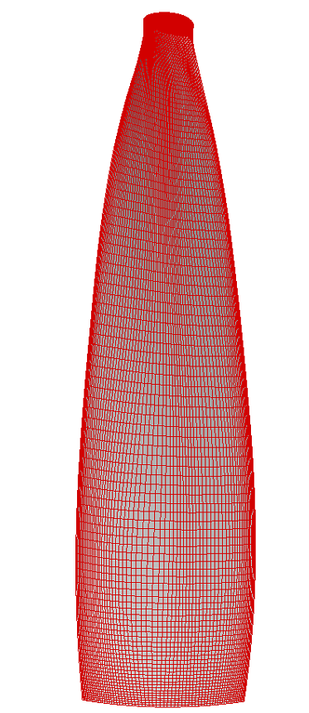
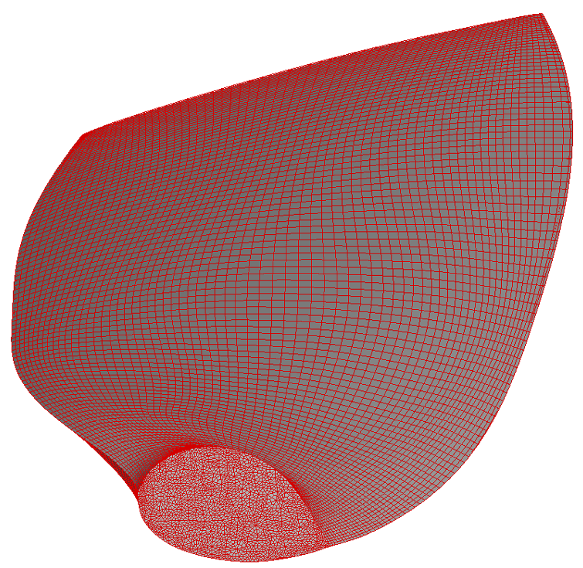
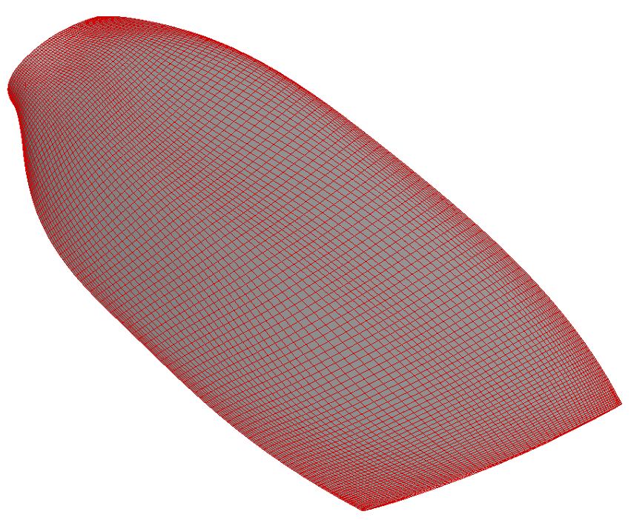
Blade Mesh (Finer)

Slide 28
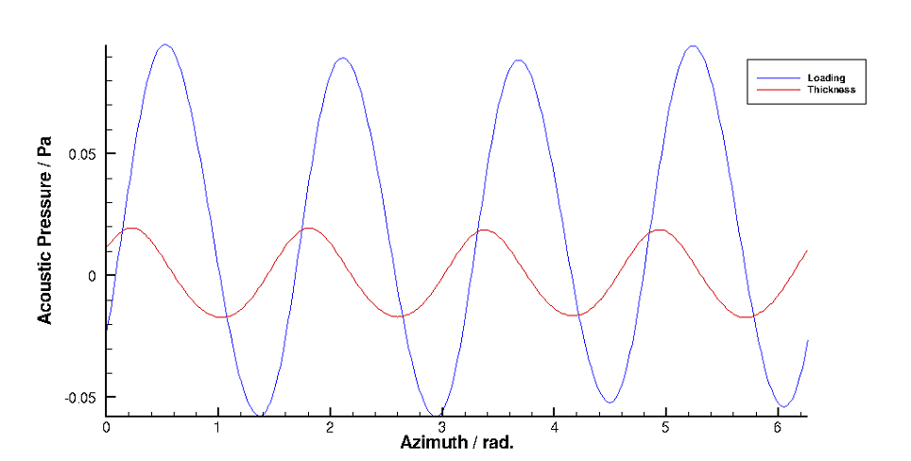
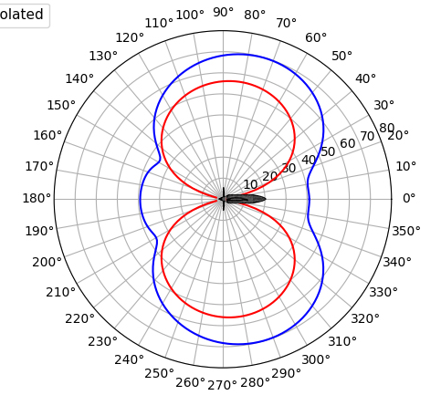
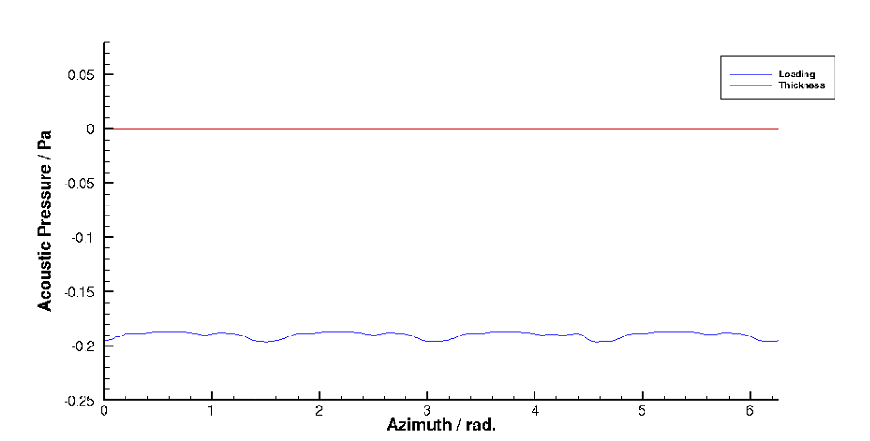
Solution to Periodic Propeller Case
OASPL in dB
Loading Noise
Thickness Noise

Slide 29
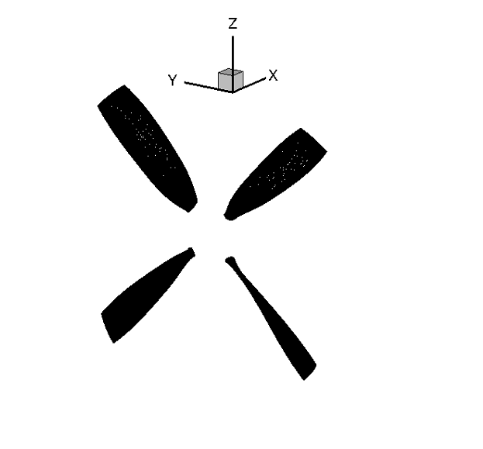
Validation of ACUM - 3
Use a propeller as the source
Geometry obtained from 1st AIAA Workshop for Integrated Propeller Predictions (WIPP)⁹
Compute acoustics for one revolution
Compare with the results obtained from ACUM-2
Compute acoustics for multiple revolutions of level-flight
Periodic output
Compare with ACUM-2 results
Propeller Model
Loading Noise
Thickness Noise
OASPL/dB

Slide 30
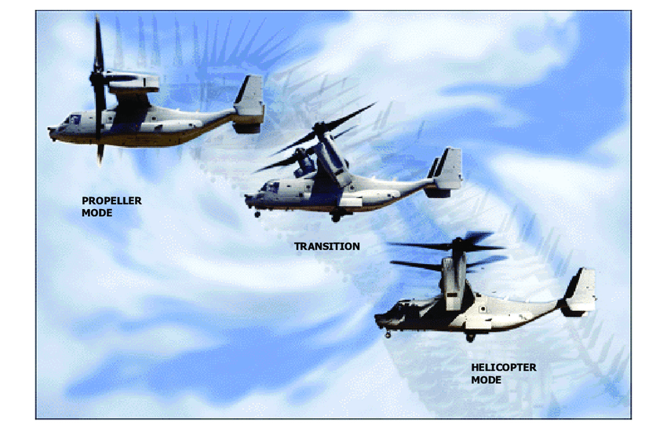
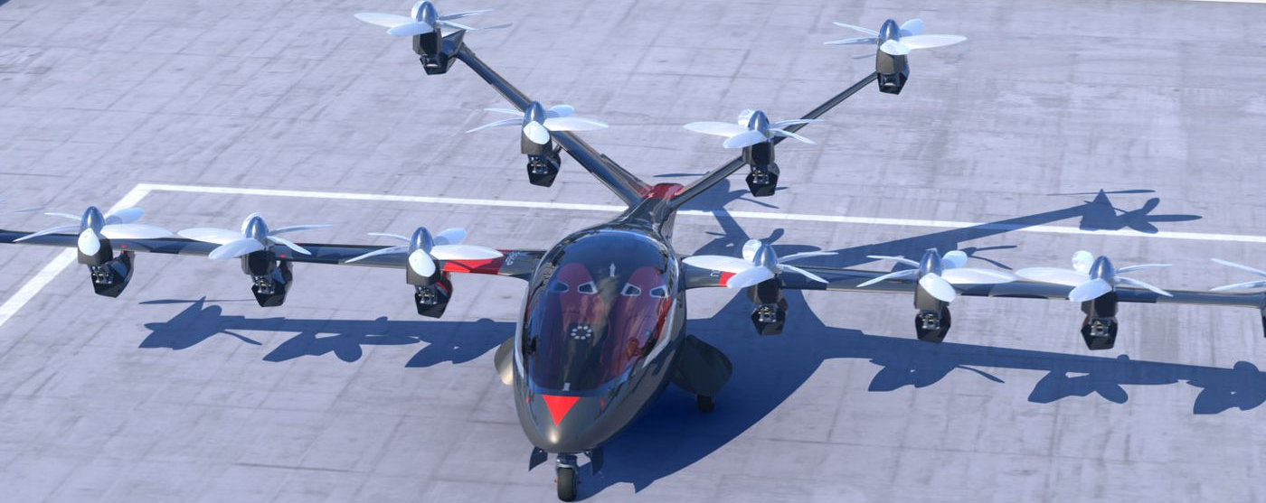
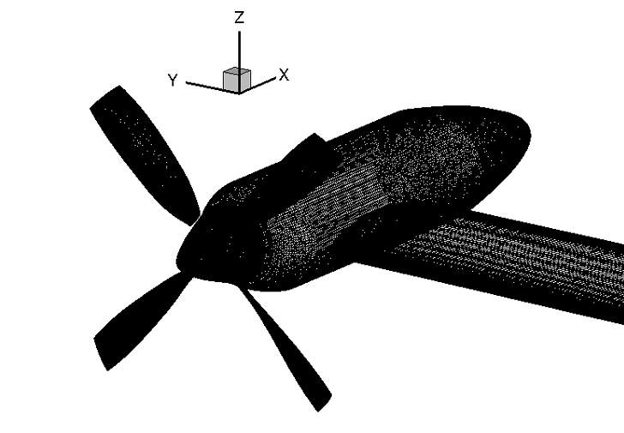
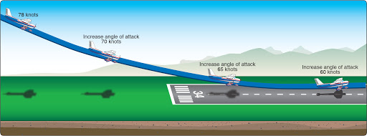
Non-Periodic Cases
Propeller RPM change
Between 20 Hz – 100 Hz
Propellers with different RPM
Acoustic pressure amplifications and cancellations with phase difference
Flyovers
Level flight
Climb/descent
Aircraft maneuvers
Turns
Climbs
Landing
Propeller shaft/blade angle of attack change
Helicopter mode to airplane mode and vice versa
First start with propeller blades
Then include
Spinner
Nacelle
Wing
Fuselage

Slide 31
Inclusion of Urban Environment
Tall buildings behave like large mirrors for acoustic pressure waves
Model them as reflecting surfaces
Assign a percentage value for reflectance
Reflecting acoustic pressure will also be added to pressure at observer
Need to assume observer located inside the building
Account for the observer time
Source
Building
Direct Wave
Reflected Wave
Imaginary Observer
Observer

Slide 32
Timeline
End of November – Finish off coding of ACUM-3
End of December – Complete modifications to CFD
End of January – Propellers with changing RPM
End of February – Change of Propeller/Wing angle of attack
End of March – Aircraft maneuver/flyover simulation
End of April – Inclusion of impermeable building surfaces

Slide 33
References
https://www.nasa.gov/aero/taking-air-travel-to-the-streets-or-just-above-them/
https://evtol.news/uber-elevate-ecrm-002/
https://www.bellflight.com/products/bell-nexus
https://www.airbus.com/newsroom/press-releases/en/2019/06/daher-airbus-and-safran-team-up-to-develop-ecopulsetm-a-distributed-hybrid-propulsion-aircraft-demonstrator.html
https://www.nasa.gov/specials/X57/index.html
Ffowcs Williams, J. E., and Hawkings, D. L., “Sound Generation by Turbulence and Surfaces in Arbitrary Motion,” Philosophical Transactions of the Royal Society of London. Series A, Mathematical and Physical Sciences, Vol. 264, (1151), 1969, pp. 321–342.
Farassat, F., and Succi, G. P., “The Prediction of Helicopter Rotor Discrete Frequency Noise,” Vertica, Vol. 7, (4), 1983, pp. 309–320.
Amiraux, M., Numerical Simulation and Validation of Helicopter Blade-Vortex Interaction Using Coupled CFD/CSD and Three Levels of Aerodynamic Modeling, Ph.D. thesis, University of Maryland, College Park, 2014.
“Wind Tunnel Testing of Propeller Wingtip Interactions,” Helden Aerospace, LLC and Empirical Systems Aerospace, Inc., 2019.

Slide 34
Thank You

